Slide 1



APPLE DEVELOPERS GROUP
Xploring Python

Slide 2
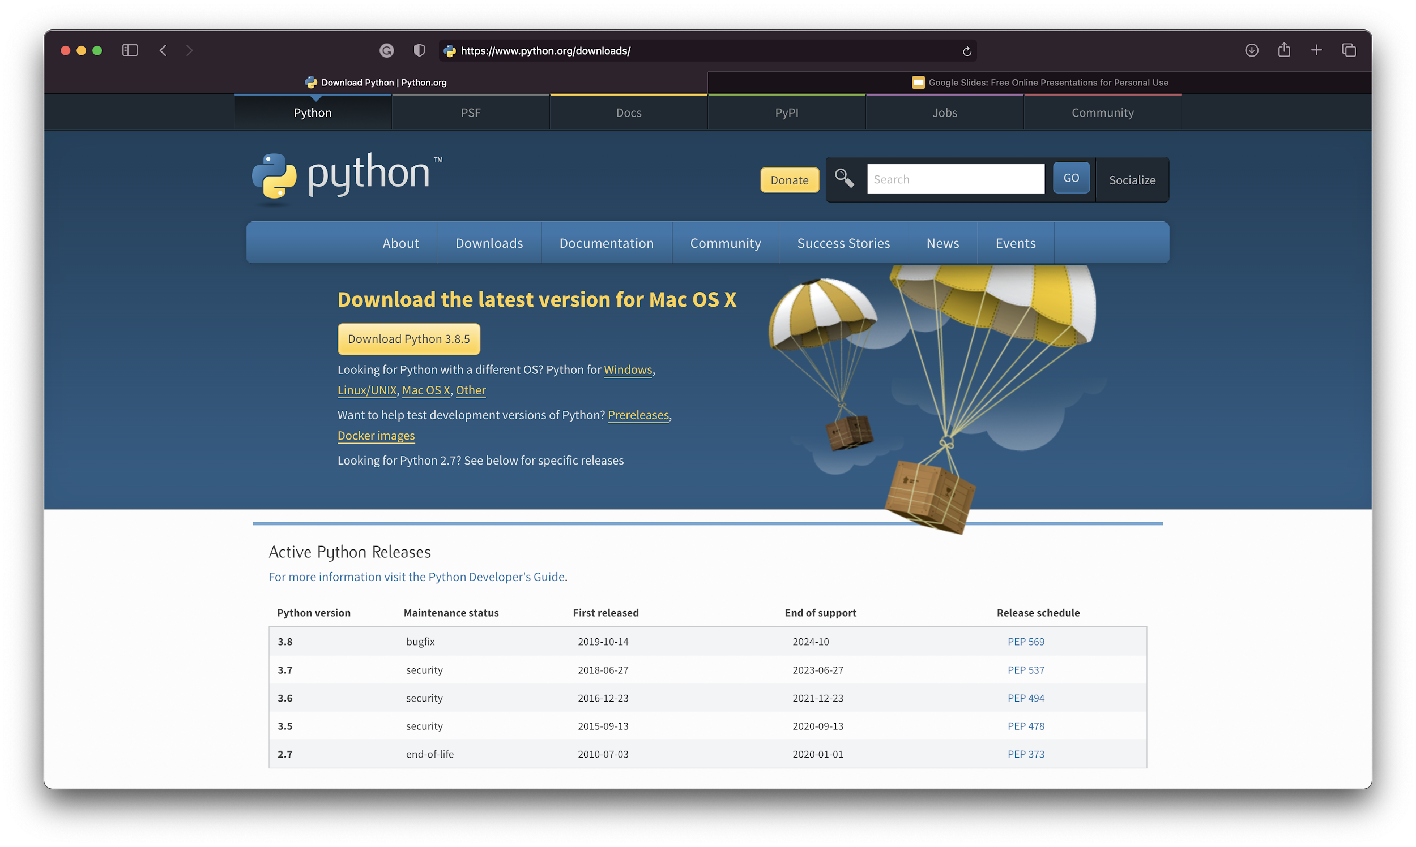
INSTALLING PYTHON
https://www.python.org/downloads/

Slide 3
KEYWORDS
APPLE DEVELOPERS GROUP
and | def | finally | in | or | while
as | del | for | is | pass | with
assert | elif | from | lambda | raise | yield
break | else | global | None | return
class | except | if | nonlocal | True
continue | False | import | not | try

Slide 4
ARITHMETIC OPERATORS
APPLE DEVELOPERS GROUP
+ | Addition
- | Subtraction
* | Multiplication
/ | Division
% | Modulus
** | Exponential
// | Floor Division

Slide 5
COMPARISON OPERATORS
APPLE DEVELOPERS GROUP
== | Equal to
!= | Not equal to
> | Greater than
< | Less than
>= | Greater than or equal to
<= | Less than or equal to

Slide 6
LOGICAL OPERATORS
APPLE DEVELOPERS GROUP
and | Returns True if both statements are true
or | Returns True if one of the statements is true
not | Returns True if the result is False

Slide 7
STRING FUNCTIONS
APPLE DEVELOPERS GROUP
len(string) | Returns the length of string
string.upper() | Converts to Uppercase
string.isupper() | Checks if string is Uppercase
string.lower() | Converts to Lowercase
string.islower() | Checks if string is Lowercase
string.replace(a, b) | Replaces `a` with `b`

Slide 8
ESCAPE CHARACTERS
APPLE DEVELOPERS GROUP
\n | New Line
\t | Horizontal Tab
\v | Vertical Tab
\” | Double Quotes
\’ | Single Quotes
\\ | Back Slash
\r | Carriage Return

Slide 9
LIST FUNCTIONS
APPLE DEVELOPERS GROUP
max(list) | Returns maximum Value in the list
min(list) | Returns minimum Value in the list
list.append(a) | Inserts `a` to the end of the list
list.sort() | Sorts the list in ascending order
list.index(a) | Returns index of `a` in the list
list.copy() | Returns the copy of the list

Slide 10
TUPLES
APPLE DEVELOPERS GROUP
Immutable Lists are called Tuples.
Lists and Tuples share most Functions.

Slide 11
DICTIONARY FUNCTIONS
APPLE DEVELOPERS GROUP
dict.clear() | Clears the dictionary
dict.get(key, default) | Returns value for the key or a default value if key is not present
dict.items() | Returns the key-value pair as a list of tuples containing (key,val)
dict.keys() | Returns the list of keys in the dictionary
dict.values() | Returns the list of values in the dictionary

Slide 12
QUESTIONS?
APPLE DEVELOPERS GROUP

Slide 13
THANK YOU
APPLE DEVELOPERS GROUP
PRESENTERS:
Ishaan Ohri,
Chairperson,
ADG-VIT
Shubhankar Shankar,
Research & Development Head,
ADG-VIT
INSTAGRAM: @adgvit
FACEBOOK: @vitios
LINKEDIN: @adg-vit

